Slide 1

Eurowings Contact Page Optimization A/B Test | August 2023.
Presented by: Chetan Sonar.

Slide 2

Agenda
Introduction
Primary Goals
Key Metrics to Track
Business Justification
A/B Test Design
Mock-Up & Insights
Q&A

Slide 3
Introduction
Eurowings has made a positive impact in digital transformation. Our website and app offer a range of features aimed at providing users with the necessary information and support they need.
Problem Statement:
High Call Centre Workload: We have observed a consistent high volume of calls to our Call Centre. This not only strains our resources but also indicates that visitors might be overlooking or bypassing digital solutions in favor of direct contact.
The data suggests a potential gap between information availability and its usage. The aim is to understand why, even with so much digital information at their fingertips, customers still prefer to pick up the phone.
Target Audience:
Non-urgent queries, First-time visitors, Repeat visitors.

Slide 4
Primary Goals
Reduce Call Centre Contacts:
Objective: To decrease the number of users relying on our call center, thereby reducing workload and costs.
Reasoning: Less reliance on the call centre implies that users are finding the digital tools effective and efficient for their queries.
Increase FAQs & Contact Form Utilization:
Objective: To increase the number of users accessing the FAQs section and using the Contact Form for their inquiries.
Reasoning: Leveraging these digital tools can provide immediate answers and support to users, improving their experience and reducing the need for direct calls.

Slide 5
Key Metrics to Track
Call Centre Clicks: A decrease in this metric will signify reduced user intent to reach out to the call center directly.
FAQ Page Views: An uptick here demonstrates a higher engagement with our FAQs, suggesting users are seeking answers from this resource.
Contact Form Submissions: More form submissions indicate users are opting for this digital channel for their inquiries, rather than making a direct call.
Average Session Duration on Contact Page: Tracking Average Session Duration helps gauge user engagement and content relevance on the contact page.
CTA (Call-to-Action): Effectiveness determines how well the page drives desired user actions.

Slide 6
Business Justification
Why prioritize this topic?
The modern customer journey emphasizes seamless self-service. By promoting self-service solutions, we can improve customer experience and reduce the operational costs associated with call center operations. Prioritizing this topic ensures we are in line with digital best practices and increases customer satisfaction by providing instant resolutions.
Benefits of running the test:
A/B testing on our contact page will provide insights into user behaviour, allowing us to understand which features or designs encourage users to opt for self-service. This in turn will lead to reduced call center workload, leading to cost savings and more efficient use of resources.
Risks of not running the test:
Without numerical evidence from A/B testing, our decisions might be based on assumptions which could be inaccurate. This could lead to missed opportunities in optimizing the user experience and in reducing operational costs. Also, failing to adapt may lead to an increased reliance on the call center, reducing efficiency and potentially affecting customer satisfaction.

Slide 7
Glossary
Metrics/KPIs | Explanation
Click-Through Rate (CTR) | Measures the percentage of users who click on specific components (like the Contact Form, FAQ section, or Call Centre info).
Contact Form Submissions | The number of forms submitted by users, which can be an indicator of increased self-service engagement.
FAQ Pageviews | The number of times the FAQ section was accessed, or specific questions were viewed.
Average Session Duration on Contact Page | How long users spend on the contact page can give insights into their behavior. An increase can imply they're spending time filling out the contact form.
Conversion Rate of Contact Form | Beyond just submissions, knowing how many users start filling out the form and complete it can give insights into the form's usability.
Above-the-fold | Upper half of a web page, visible without scrolling down the page
CTA (Call-to-Action) | Combination of visual and text elements prompting users to take action.

Slide 8
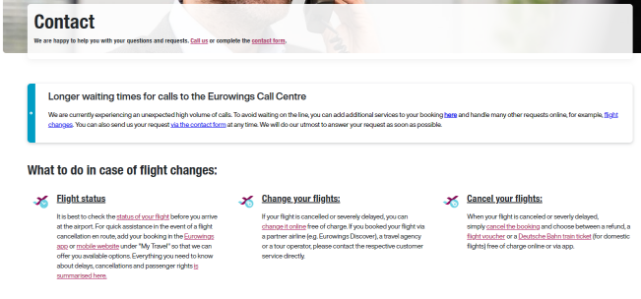
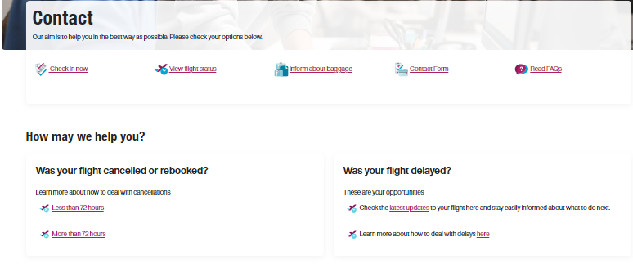
A/B Test Design: Feature Contact Form and Read FAQs above the fold.
Variant A
Variant B
Variant A: Current Website Design
The existing website layout with limited emphasis on the Contact Form and FAQ section.
Users can still access self-service options but might need to navigate deeper into the site to find them.
Variant B: Enhanced Self-Service Emphasis
The Contact Form and FAQ section are prominently featured Above-the-fold. Visual cues and prominent buttons guide users toward self-service options.

Slide 9
Hypothesis
If we redesign the contact page to prioritize and feature the FAQ section and Contact Form featured Above-the-fold, then we can expect a reduction in Call Centre clicks and an increase in FAQ Page Views and Contact Form submissions.
This hypothesis directly links the design change (independent variable) to the expected outcomes (dependent variables) and sets a clear direction for the test.
Variant A vs. Variant B: Key Metrics
Metrics | Variant A | Variant B | % Change | Probability to Beat Variant A | Interpretation
Call Centre Clicks | 5,000 | 3,200 | -36% | ≥95% | VALIDATED
FAQ Page Views | 2,500 | 4,800 | +92% | ≥95% | VALIDATED
Contact Form Submits | 1,500 | 3,000 | +100% | ≥95% | VALIDATED

Slide 10
Insights
Call Centre Clicks: Variant B shows a decrease in Call Centre clicks by 36% compared to Variant A. This means fewer users are looking to contact the Call Centre, reducing potential workload.
FAQ Page Views: Variant B resulted in a 92% increase in FAQ page views compared to Variant A. This substantial rise indicates that users are actively looking for answers on the FAQ section, which is a positive sign for self-help.
Contact Form Submits: The number of users submitting the Contact Form doubled in Variant B. This two-fold increase suggests that users find the new design more encouraging and are more inclined to get their queries addressed through the form.
Conclusions
Variant B demonstrates a stronger inclination towards self-service among users, which aligns with the objective of the test. The reduced Call Centre interactions, combined with improved FAQ engagement and contact form submissions, highlight the effectiveness of the changes implemented in Variant B.

Slide 11

Probability thresholds definition and meaning
Probability threshold | Terminology | Meaning / Interpretation
≥95% probability to beat the Variant A | VALIDATED | We have high confidence that there is a positive impact on the KPI. We consider a causal impact to be proven
≥90% and-<95 probability to beat the Variant A | DIRECTIONAL | The probability is high that there is a positive impact on the KPI, and we can cautiously comment on the results.
>10% and <90% probability to beat the Variant A | FLAT | Impact on KPI is consider to be random chance / noise in the data. We do not comment on the results.
≤10% and >5% probability to beat the Variant A | DIRECTIONAL | The probability is high that there is a negative impact on the KPI, and we can cautiously comment on the results.
≤5% probability to beat the Variant A | VALIDATED | We have high confidence that there was a negative impact on the KPI. We consider a causal impact to be proven.

Slide 12
Analysis of Key Metrics on Contact Page
Average Session Duration on Contact Page:
Data: Session duration increased from 2 minutes (Variant A) to 2.5 minutes (Variant B).
Analysis: The longer session duration suggests that users were more engaged with the content or design on the contact page in Variant B.
CTA (Call-to-Action):
Data: CTA click-through rate increased from 10% (Variant A) to 15% (Variant B).
Analysis: The improved click-through rate for the CTA indicates that the call-to-action in Variant B was more due to clearer messaging, a more noticeable design, or better positioning.

Slide 13

Thank you for your attention!

